Slide 1
GPU-Accelerated Python Programming with Numba
Presentors:
ISAIC Tech Team
DATE:

Slide 2

Today’s Discussion
Who we are and more about ISAIC?
CPU vs. GPU computations
GPU and Parallel Computing
Introduction to Numba
Tutorial

Slide 3
ISAIC is powering the A.I.mbition in Western Canada
Small to medium size start ups
Accelerate AI adoption and commercialization
By abstracting away hardware management

Slide 4
We offer High-performance Computing Virtual Machines
At ISAIC, we offer different flavours of high-performance VMs that come preconfigured and specifically tailored to their needs
Our services come with 1 to 8 GPUs and up to 64 CPU cores with 512GB RAM
Our offerings come ready with AI tools including newest libraries from TensorFlow, Torch, & Keras
We offer in-person expert consultation to our clients and help them through their AI journey

Slide 5
Today, we will see how ISAIC creates and uses VMs for our clients
What is a Virtual Machine?
Through virtualization we can divide existing hardware resources into multiple machines and create virtual hardware that our Operating Systems run on …..
Let’s set aside the technical terminology and definition and take a look at virtualization from an operational point of view

Slide 6
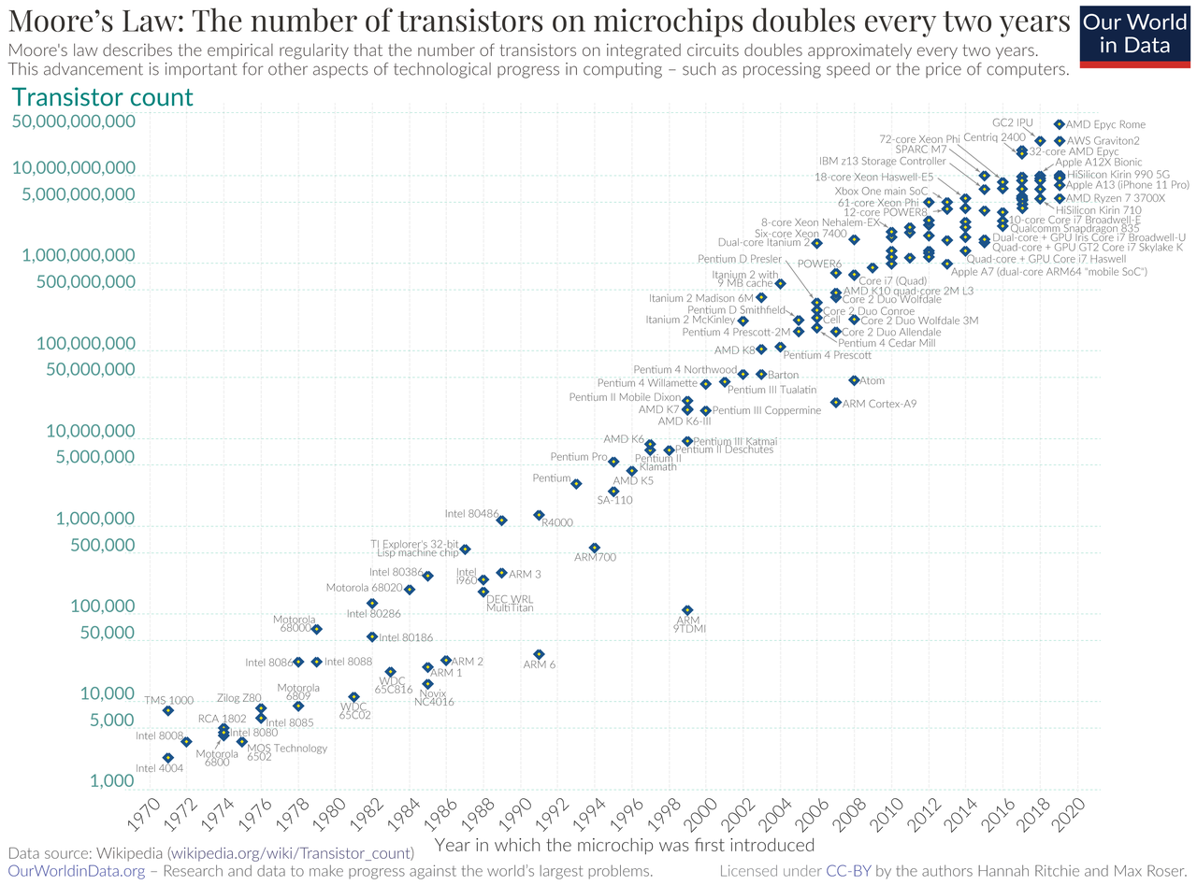
Why do we need GPUs?
Transistors today are of size ~10nm
In recent years, shrinkage of transistor has slowed down
Moore’s law hitting the physics limitation
However we need higher computation power than ever before to process exponentially growing data
GPUs come to the rescue by using the distributed parallel computing

Slide 7
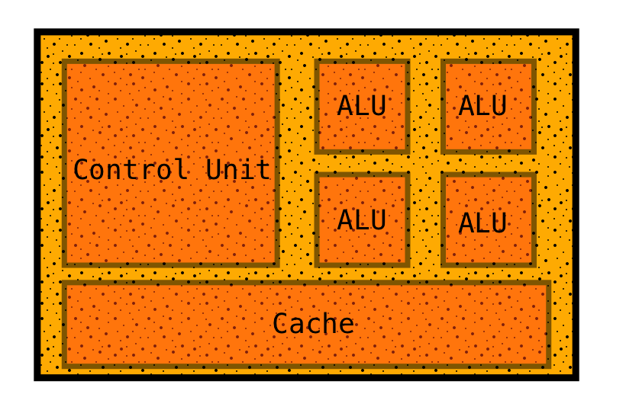
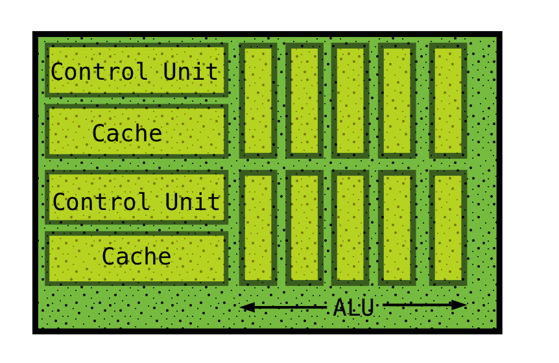


CPU Vs. GPU
CPU
GPU
Serial vs. parallel computing
Several cores vs. thousands of cores
Fast and versatile vs. high throughput
System memory vs. graphics card memory
Cache memory management
﻿﻿https://www.vectorstock.com/royalty-free-vector/juggling-balls-vector-10097076
https://myloview.com/sticker-baby-boy-sitting-on-the-floor-and-throwing-ball-in-the-air-vector-no-C7D1DC2
Notes:
Series of interconnected complicated task in cpu vs complex task broken into thousand/millions parallel tasks
Low latency vs high throughput
System memory easily expandable where graphics memory is not, and can cause bottle neck
Cpu cache layer structure automatic management, gpu non-uniform and user controlled for optimization

Slide 8
Advantages of GPU over CPU
CPU
GPU
Memory Bandwidth
Large Datasets
Parallelism
Cost Effective
﻿﻿https://www.vectorstock.com/royalty-free-vector/juggling-balls-vector-10097076
https://myloview.com/sticker-baby-boy-sitting-on-the-floor-and-throwing-ball-in-the-air-vector-no-C7D1DC2
Notes:
GPU has high bandwidth memory (HBM) (speed of ~1.2TBps) that is different from traditional DDR RAM (speed of ~100GBps)
: GPU efficiently handles memory heavy computations
: simultaneous use of multiple processing threads outperforms the latency problem
: GPU performs much more work for each unit of energy

Slide 9

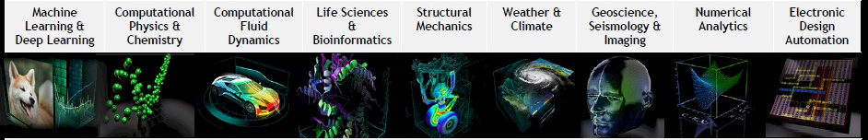
GPU at a Glance
First developed for the purpose of graphics, 3D image/video rendering
Used as special purpose graphics unit mainly for game developments
Quickly transformed into general purpose computing device and sparked AI boom, became integrated part of modern supercomputers
GPU is complementary to CPU, NOT a replacement
https://inspirationfeed.com/game-worlds/
https://digital.hbs.edu/platform-digit/submission/nvidias-winning-platform-strategy-with-cuda/

Slide 10
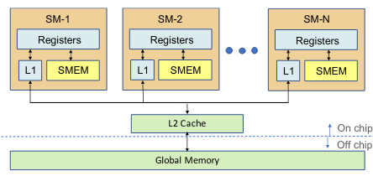
Diving Deep into GPU Architecture
Compute units called Streaming Multiprocessors (SMs)
Each SM has a number of cores, registers and shared memory (SMEM) and L1 cache local to each SM
Shared memory utilization is programmable
Data flow: SM ->L1 cache -> L2 cache -> global memory
https://arxiv.org/pdf/2003.01178.pdf
Notes:
SMEM is controlled by user for better memory optimization and shared across all cores in the SM

Slide 11
Diving Deep into GPU Processing
GPU processes large number of threads (tasks) organized into thread blocks
Each thread block is run by one SM
Thread blocks are further divided into subgroups of threads called warps (usually consisting of 32 threads)
Threads of a warp execute a Single Instruction Multiple Threads (SIMT) model
SIMT model is the execution mechanism that gives GPU the power of parallel computing
https://arxiv.org/pdf/2003.01178.pdf
Notes:
- in simple words, all threads execute same code/instruction but on different data

Slide 12
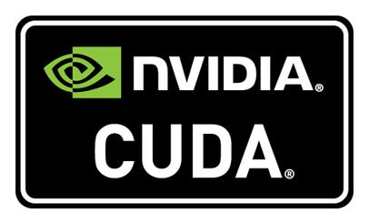
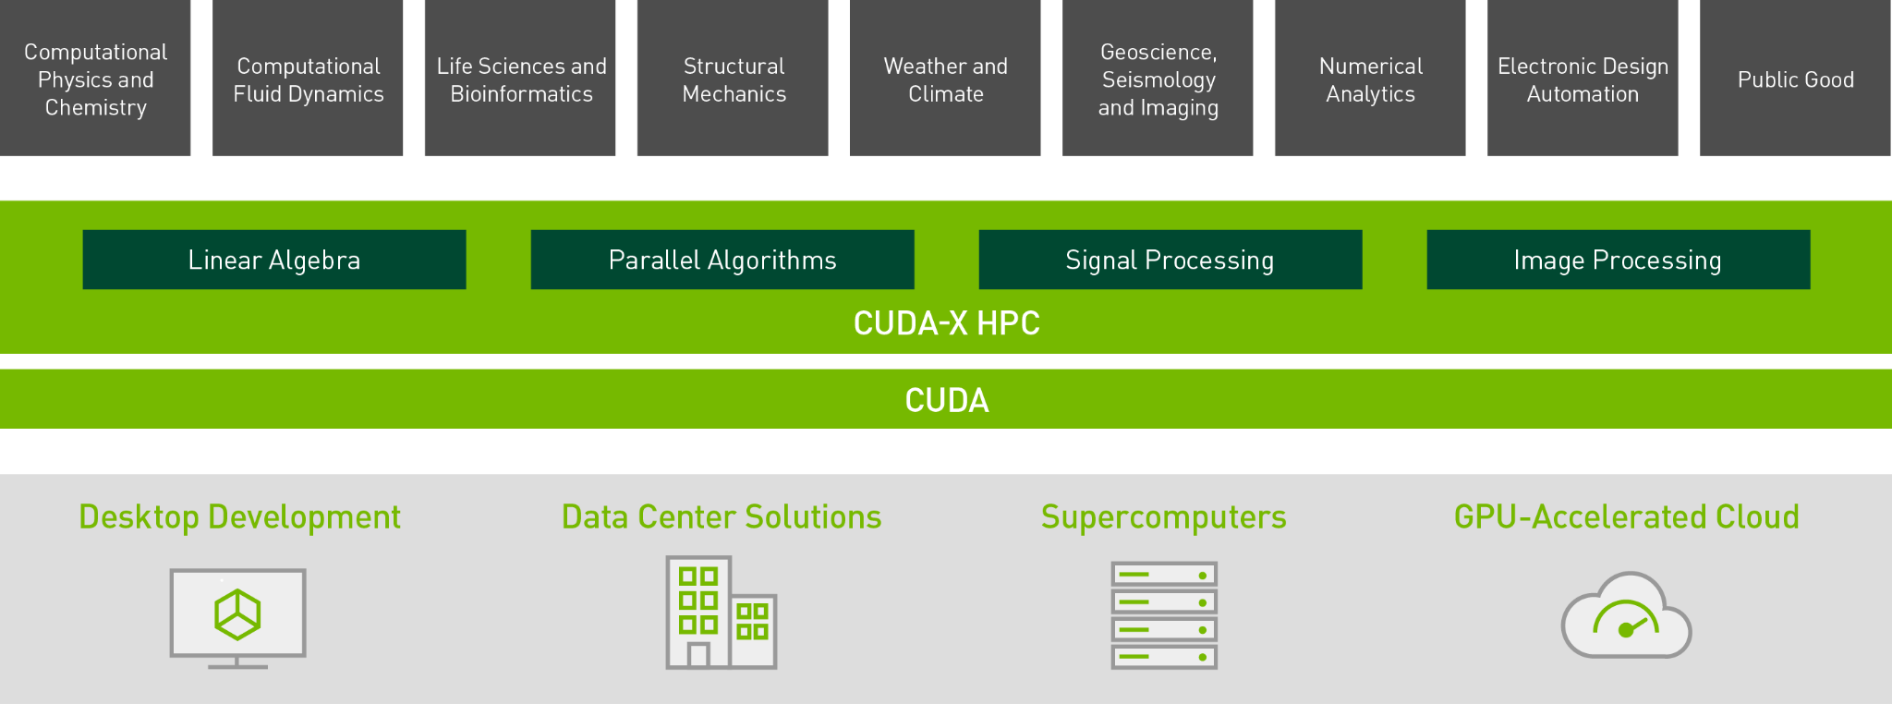
APIs to implement SIMT: Introduction to CUDA
CUDA is a software platform that implements parallel computing
Developed by NVIDIA with first release in 2007
Designed to work with programming language C, C++, FORTRAN
Like CUDA, there are other parallel programming models e.g. ROCm, OpenCL
These APIs and libraries built on top of them provide GPU the massive power to build high performance computing (HPC) and cutting edge AI solutions
In our tutorial, we will learn how to convert traditional python code into GPU-accelerated code that runs on CUDA supported devices
https://en.wikipedia.org/wiki/CUDA
https://www.nvidia.com/en-us/technologies/cuda-x/

Slide 13

Accelerated Python Programming: Introduction to Numba
Numba is a “just-in-time” (jit) compiler for python
Works best on code that uses NumPy, functions and loops
Requires very little modification to existing python code
Optimizes python functions for both CPU and CUDA based GPU
pyCUDA is an alternative option for Numba, but requires writing C code in python and a lot of code modification
In our tutorial, we will first learn how to use Numba to compile python functions for CPU, then switch to GPU acceleration using Numba compiler

